Slide 1
Lending club case study
Group Members:
Shamseena VM
Rajesh Kodavalli

Slide 2
Problem statement
Lending club case study assignment is to provide an idea about how real business problems are solved using EDA
It helps in understanding risk analytics in banking and financial services.
To understand how data is used to minimize the risk of losing money while lending to customers.
The case study is conducted to analyze the information about past loan customers and understand if they ‘defaulted’ or not.
To understand the driving variable which causes the customer to default the loan payment

Slide 3
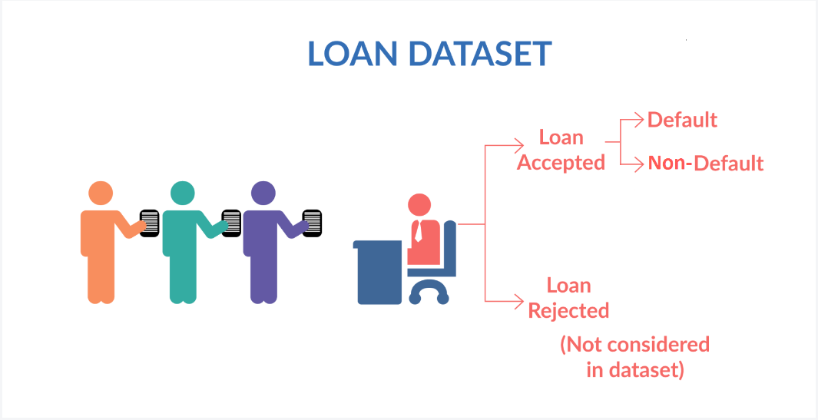
Overview of Loan Applied

Slide 4
CASE STUDY APPROACH
Analyze all plots & identify the different patterns
Identify main driving variables behind loan defaults.
Provide recommendations to reduce the loss in business
1.Data understanding
2.Data cleaning
3.Univariate Analysis
4.Segmented Univariate Analysis
5.Bivariate Analysis
6.Analysis feedback & recommendations
Analyzing two columns together.
Visualize the distribution using plots
Analyze columns against categorical columns .
Visualize the distribution using plots
Analyze single columns
Visualize the distribution using plots
Handle missing values
String & date conversions.
Create new derived columns
Load dataset.
Analyze data, columns & values
EDA Process

Slide 5
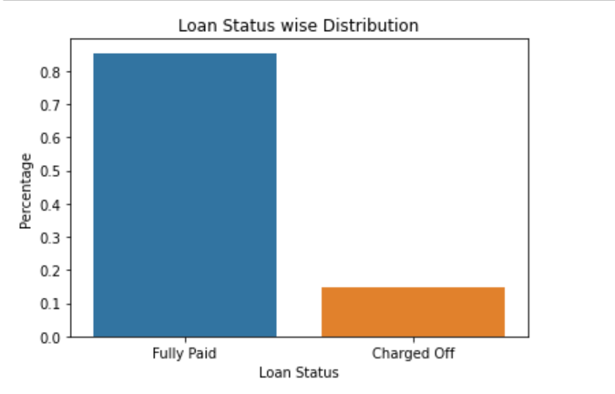
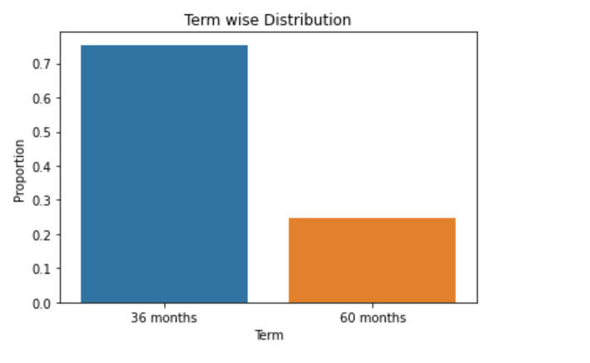
Univariate Analysis
Loan Status column
Term column
More then 80 % of customers are fully paid the loan
Almost 15% of customers charged off/defaulted
More then 75 % of customers are fully paid the loan who opted 36 month term for loan payment
Almost 24% of customers charged off/defaulted who opted for 60 month term for loan payment

Slide 6
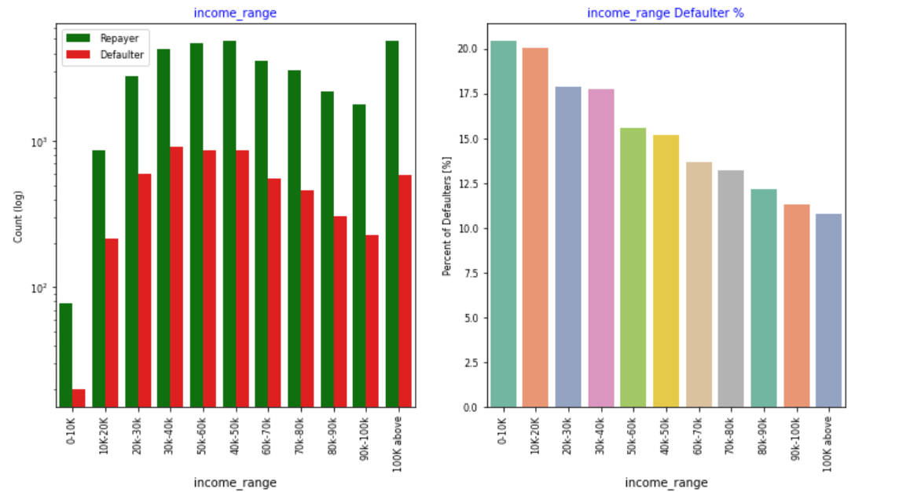
Univariate Analysis
The customers with income below 20k higher default percentage(~21%)

Slide 7
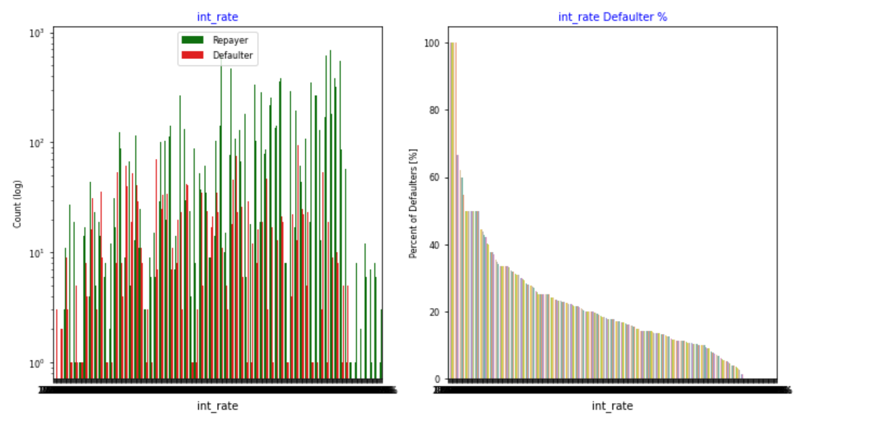
Univariate Analysis
With higher interest rate, higher the default rate

Slide 8
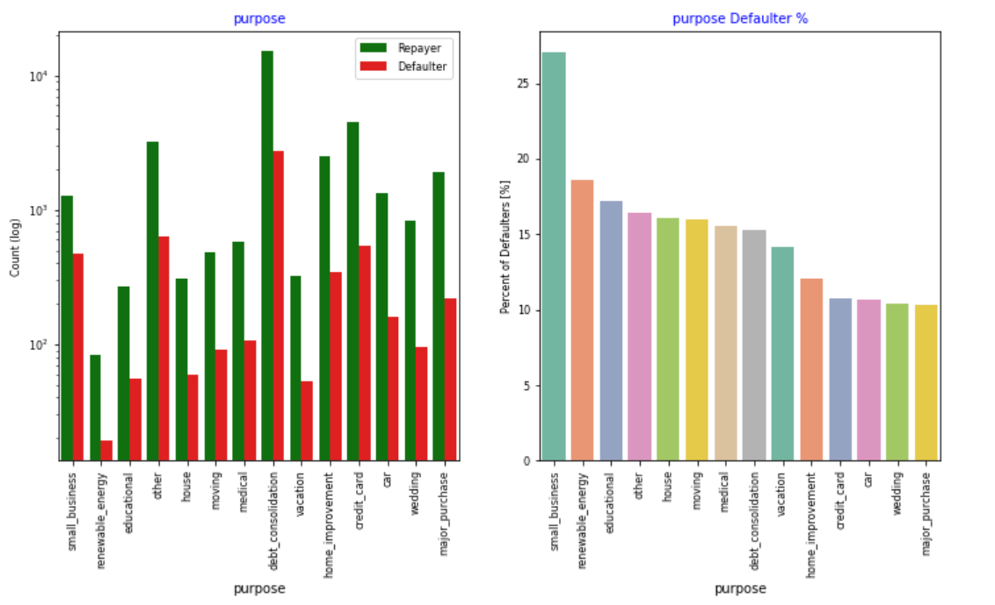
Univariate Analysis
The customers who take loan for samll business have high default percentage(~27%)

Slide 9
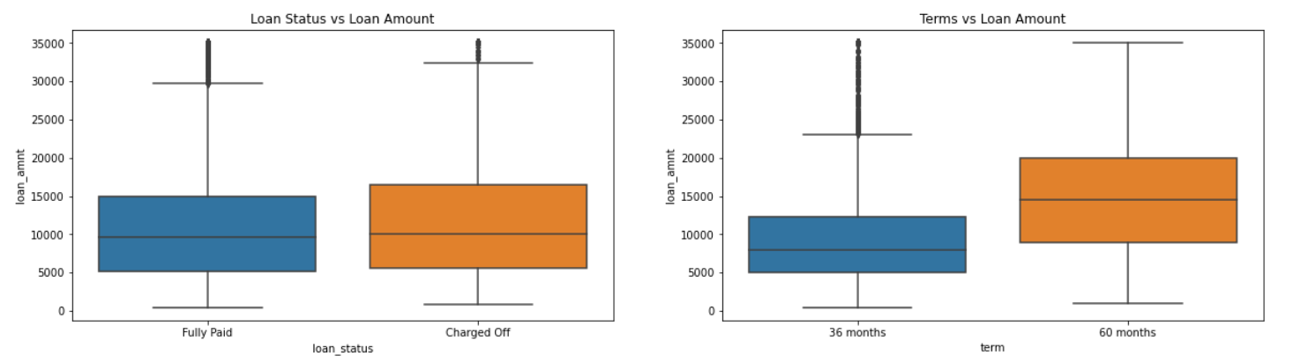
Segmented Univariate Analysis
loan_status vs loan_amount & term vs loan_amount column

Slide 10
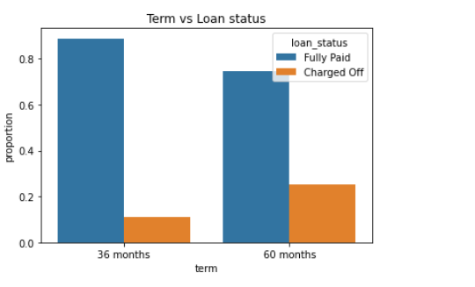
Bivariante Analysis
Term vs loan_status
The default rate is high in 60 months tenure because most people took high loan amount with high interest rate in it and they faced difficulties in returning the sum to bank

Slide 11
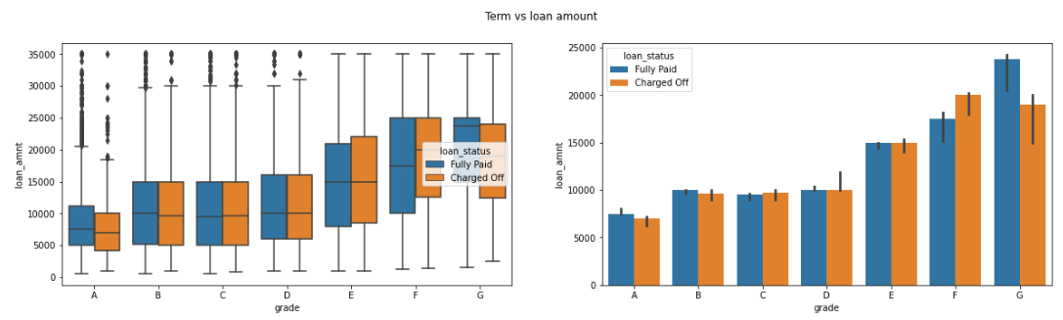
Bivariate Analysis
Term vs loan_amount
For lower grades 'F' and 'G' there are more difference between charged-off and fully paid.
The lower grade people has taken higher amount of loans and also they are more prone to default the loan.

Slide 12
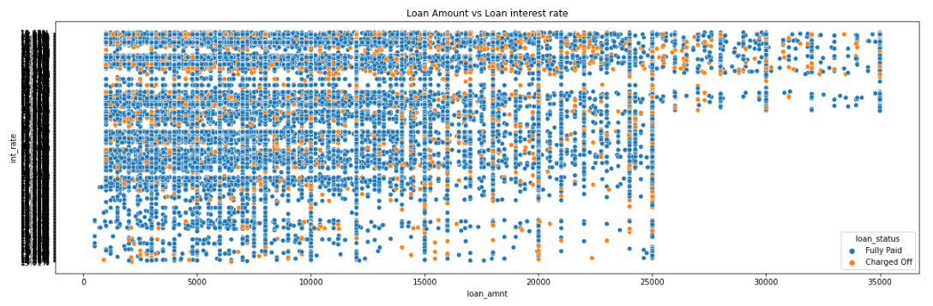
Bivariate Analysis
Loan amount vs interest rate
For lower grades 'F' and 'G' there are more difference between charged-off and fully paid.
The lower grade people has taken higher amount of loans and also they are more prone to default the loan.

Slide 13
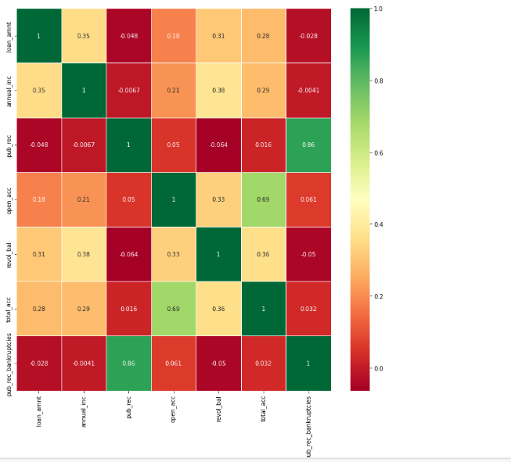
Correlation
The above figure showsthe correlation between of defaulted customer

Slide 14
Main driving variables for customer default
Term
Loan amount
Purpose
Interest rate
Income

Slide 15
Conclusion
We can work on the Data with fully paid and Defaulted customers base.
We can create model on the above data to figure out the driver variables of default customers.
The model from above steps can be used to figure out the probability of an existing customer/ New customer to default

